Slide 1
DATA SCIENCE GUIDE

Slide 2
Presentation summary
DATA COLLECTION
DATA CLEANING
DATA ANALYSIS
DASHBOARD CREATION (POWER BI)
DASHBOARD CREATION (STREAMLIT)

Slide 3

Data collection
Data was collected and generated through faker
Image 1: Python Random Data Generator

Slide 4
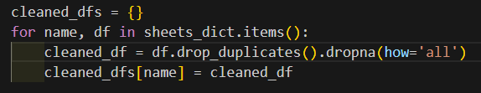
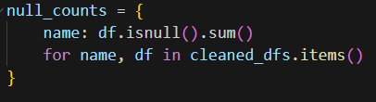
Data CLEANING
Data was checked for nulls & duplicates through pandas
Image 2: Removing Duplicates (Pandas)
Image 3: Checking for Nulls (Pandas)

Slide 5
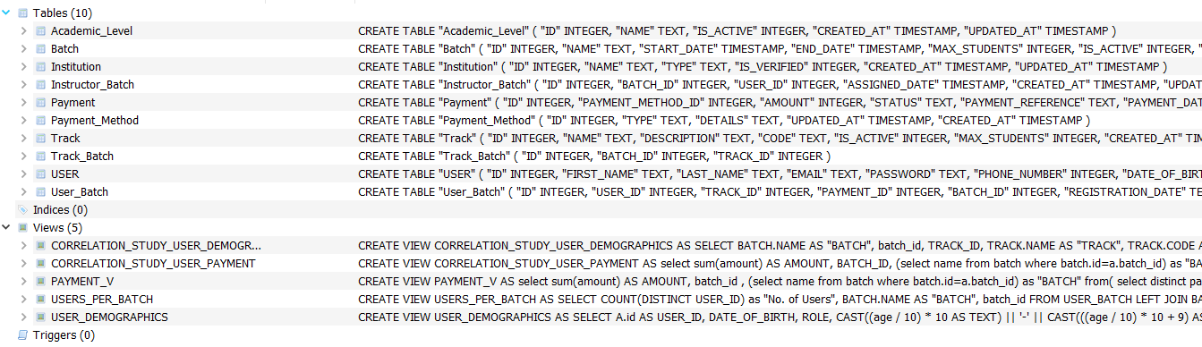
Data CLEANING
Data was exported to SQL Lite to create a database
Views were created to check for correlation & the dashboards(for later steps):
CORRELATION_STUDY_USER_DEMOGRAPHICS
CORRELATION_STUDY_USER_PAYMENT
PAYMENT_V
USERS_PER_BATCH
USER_DEMOGRAPHICS
Image 4: Registration App Database (SQL Lite)

Slide 6
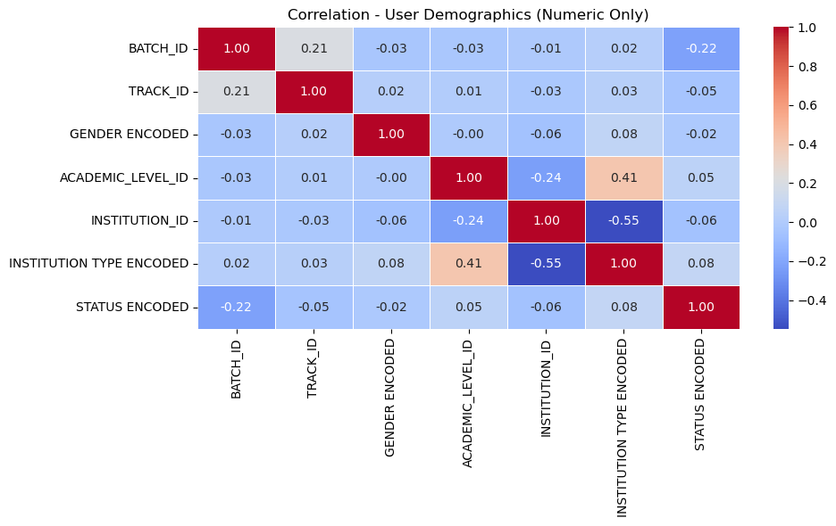
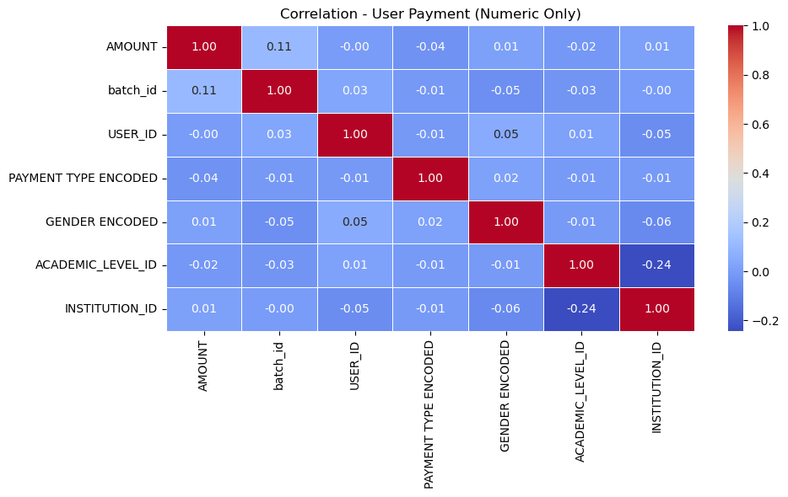
Data Analysis
Views were made while encoding text data to integers to test for correlation
Heat maps are then generated using python (seaborn & pyplot)
Image 5: Heat Map (User Demographics)
Image 6: Heat Map (User Payment)

Slide 7
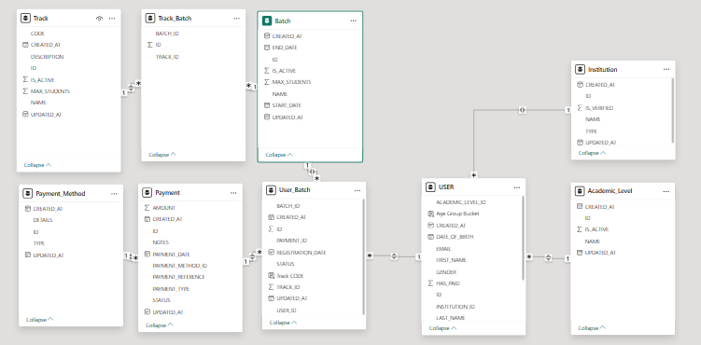
Dashboard creation (power bi)
Data was imported into power bi where the links where checked for proper filtering
Image 7: Model View (Power Bi)

Slide 8
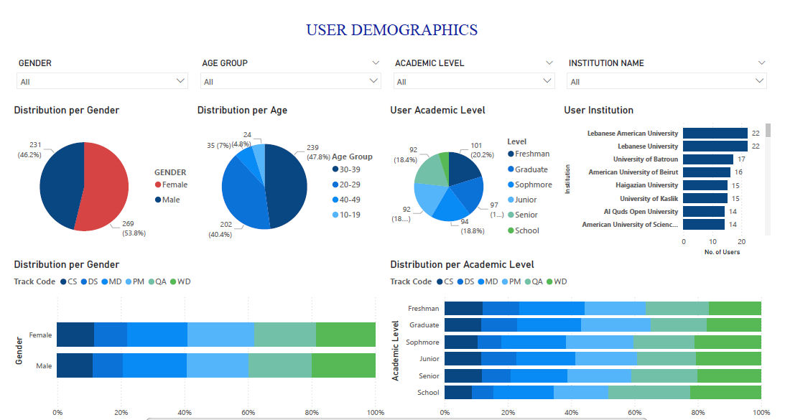
Dashboard creation (power bi)
Image 8: User Demographics – Page 1 in Power Bi

Slide 9
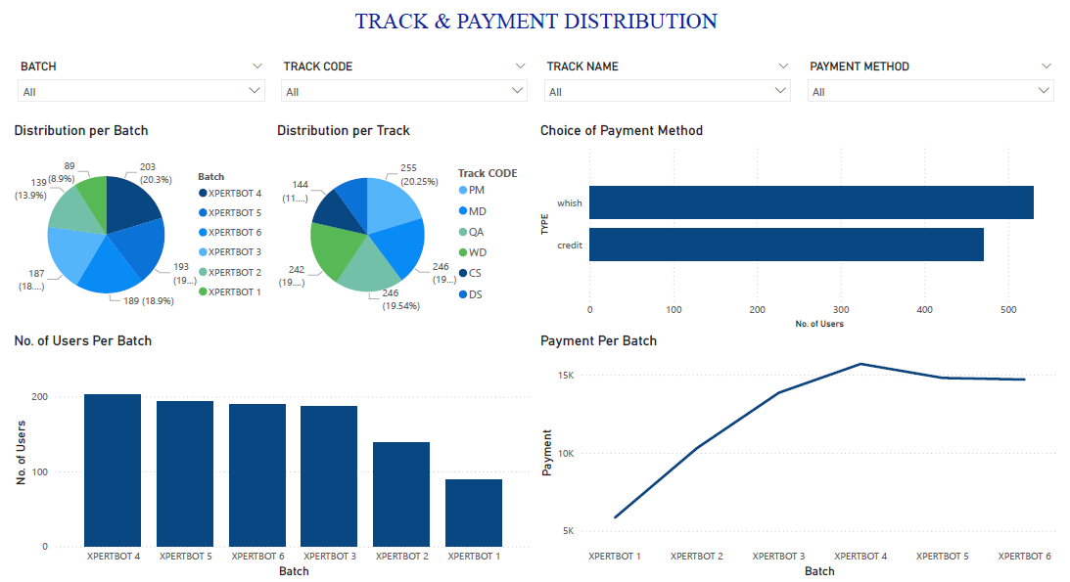
Dashboard creation (power bi)
Image 9: Track & Payment Distribution – Page 2 in Power Bi

Slide 10
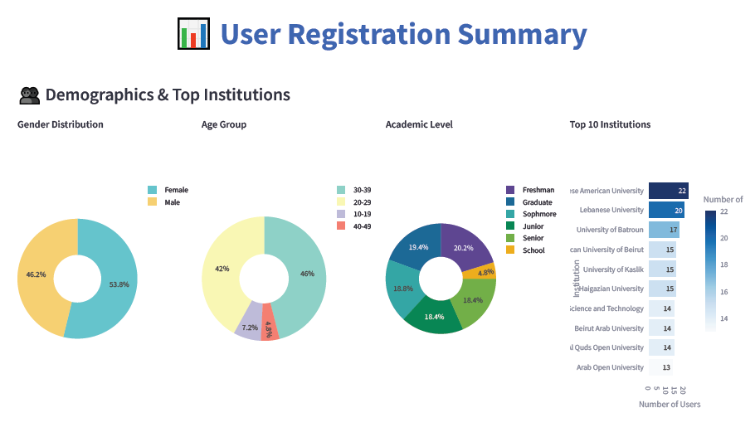
Dashboard creation (Streamlit)
Image 10: Demographics & Top Institutions (Streamlit)

Slide 11
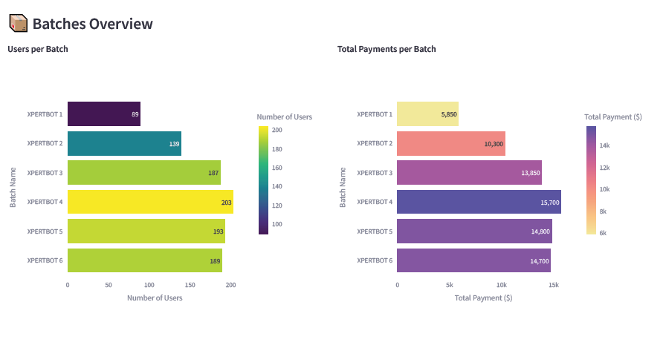
Dashboard creation (Streamlit)
Image 11: Batches Overview (Streamlit)

